Slide 1

Hackers
Lama Ahmad, NYUAD, UAE
Fahmi Alnajjar, PSUT, Jordan
Maha Amjad, NUCES FAST, Pakistan
Skye Im, New York University Shanghai, China
Shorook Saleh, University of Sharjah, UAE
Mentors
Anas Shahrour, Hamza, Founder, UAE
Balsam Alkouz, UOS, Research Assistant, UAE
Hanan Hadad, Lynx Vision, Graphic Designer, UAE
Saeed Motamed, NetworkFull, CTO, UAE

Slide 2
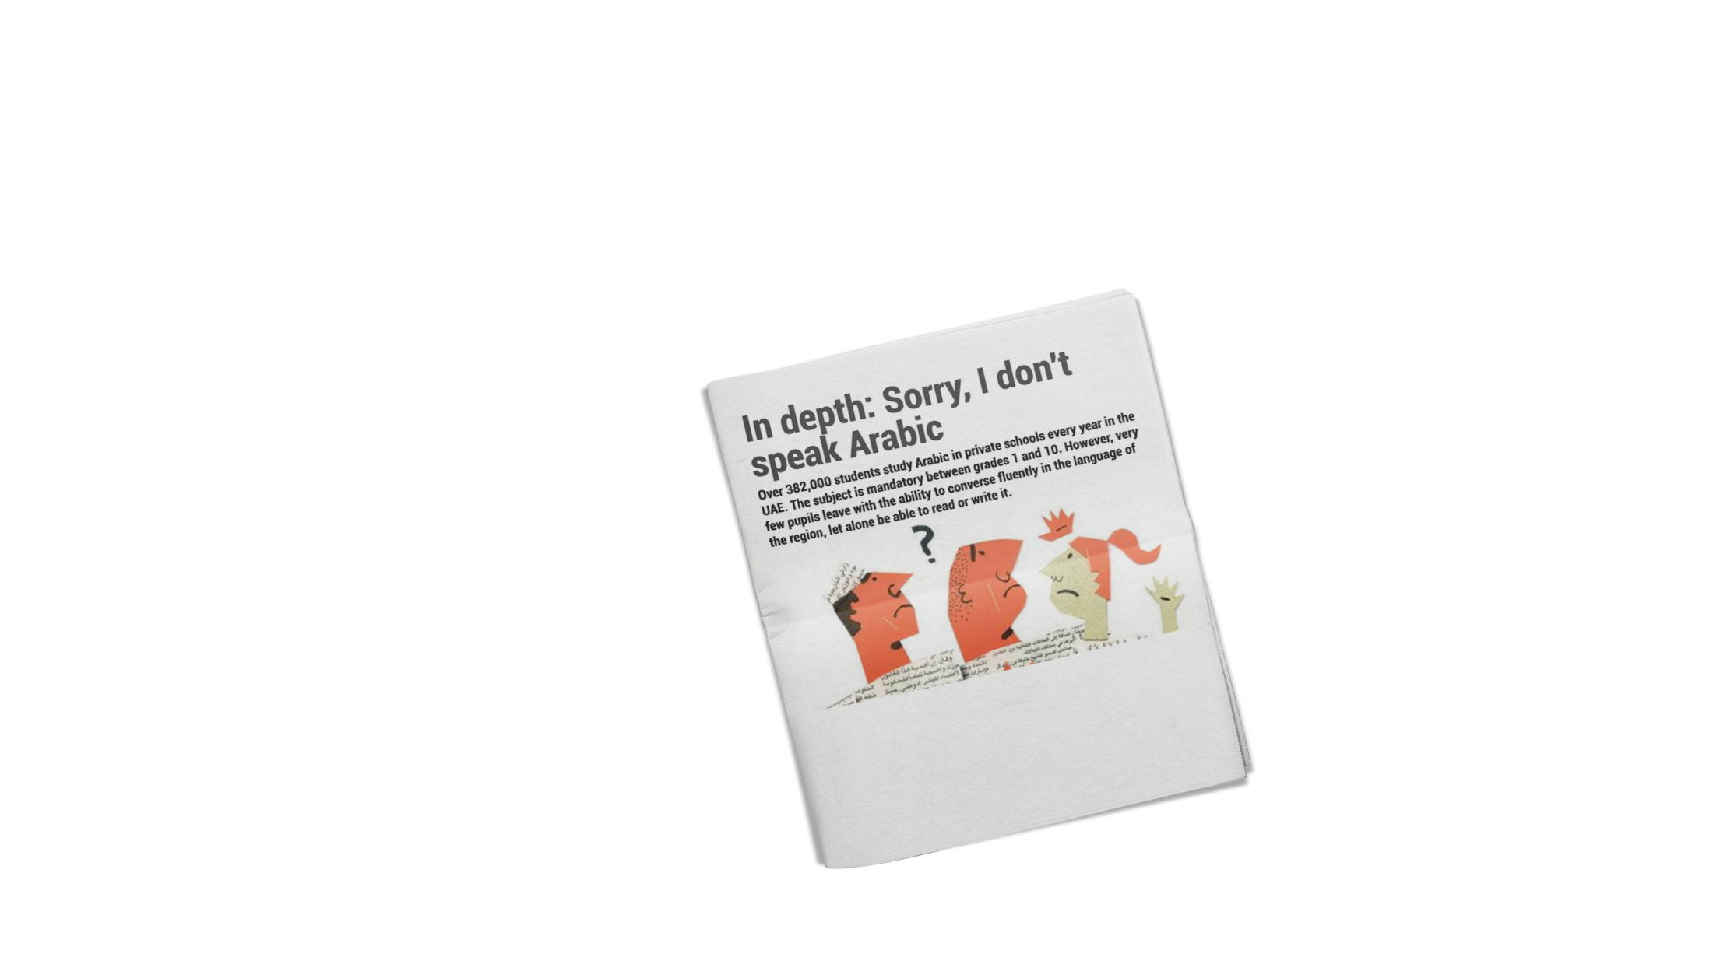
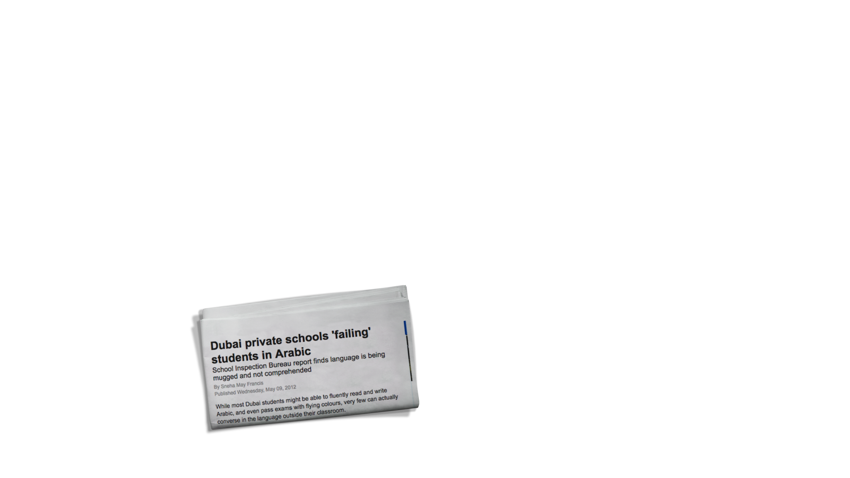





Slide 3



Problem
Learning Arabic Grammar

Slide 4
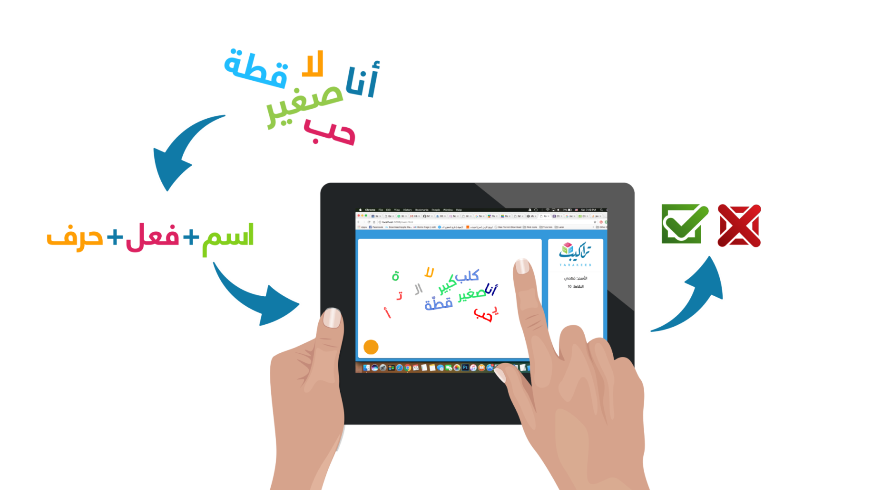
Our Solution

Slide 5


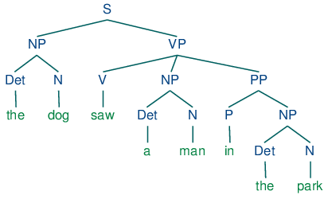





Our Solution

Slide 6

Impact
Enjoyable Learning Experience
A+

Slide 7



Future Development

Slide 8
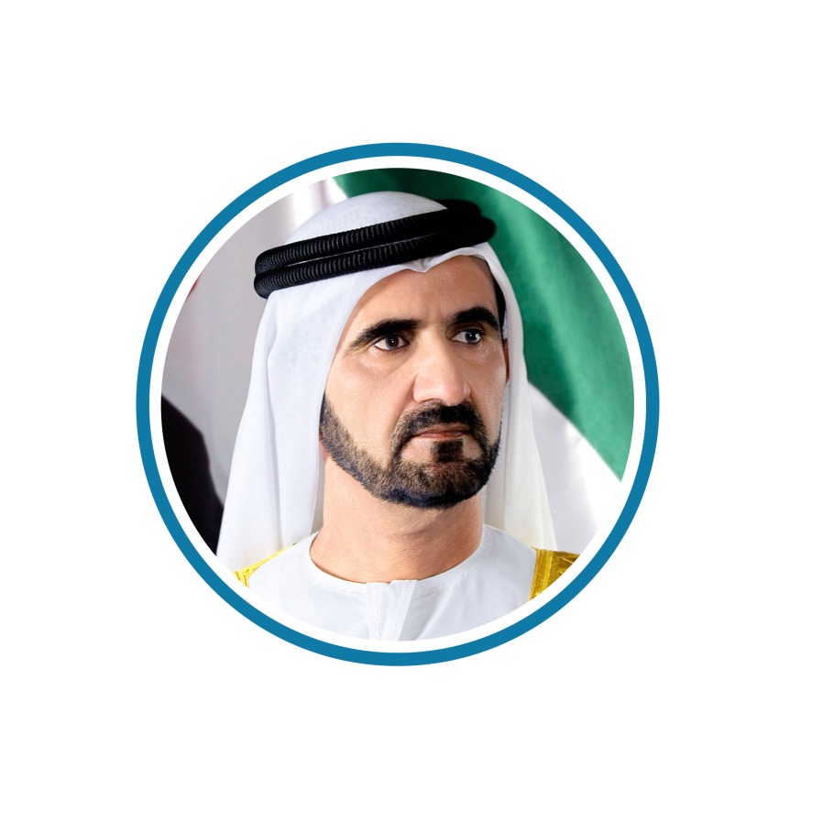
“ The interest in the Arabic language and the development of tools and methods of teaching is an integral part of our vision and aspirations for a better future for the UAE and is not less important than the interest in education in all its other branches. ”
HH Sheikh Mohammed Bin Rashid Al Maktoum

